Slide 1
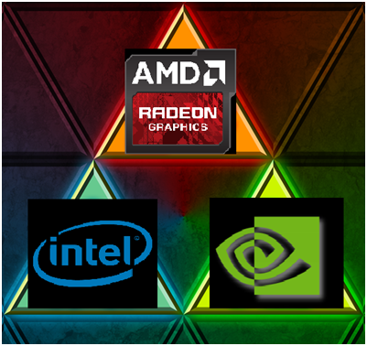

Topic modeling on amd and Nvidia's gpu launch comments
Done by: N Kumeresh, dsi 18

Slide 2
Contents
Introduction
Background
Problem Statement
Scrapping the data
Data Cleaning
3. EDA on comments
AMD
Nvidia
4. Modeling and further EDA
AMD
Nvidia
5. Project Limitations
6. Conclusion

Slide 3


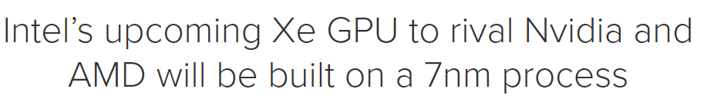
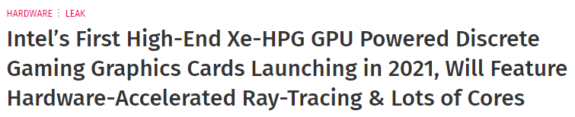
Introduction: Background
Intel is planning to release their first gaming graphics card into the market.
They’re intending to compete against AMD’s RDNA and Nvidia’s Ampere series.
Notes:
Intel is a technology company that manufactures microprocessors, motherboard chipsets.

Slide 4
Introduction: Problem statement
As a data scientist working in intel, my team is tasked with understanding the consumer behavior surrounding the launch of AMD and Nvidia’s GPUs.
Based on our research, majority of the fanbase primarily resides in their respective subreddits.
This problem is solved by conducting topic modeling on the comments understand what are the consumers looking out for when purchasing a GPU to ensure a smooth release of our own GPUs.
Notes:
To look out for what type of features consumers are looking for when purchasing a GPU as well as the problems faced during the launch

Slide 5
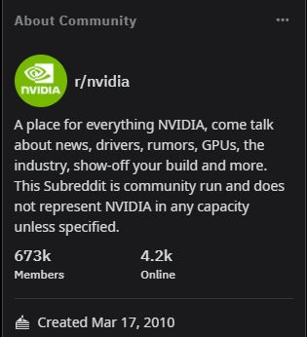
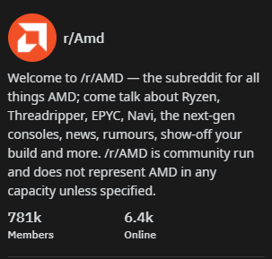
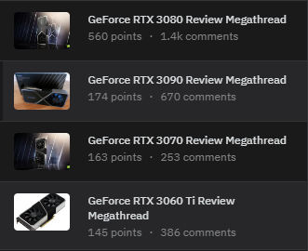
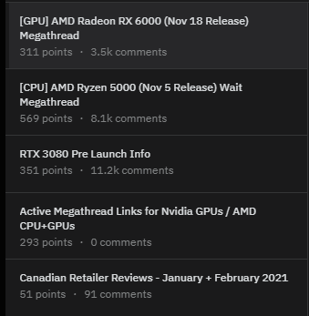
Scrapping The data
Scrapped using PRAW’s API
A total of 34,000 comments were scrapped
Notes:
Generally, talk about the respective subreddit

Slide 6
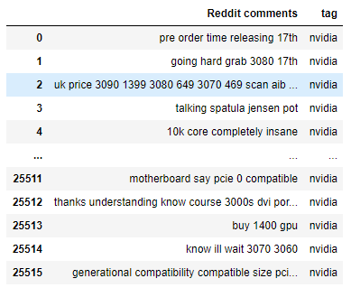
Cleaning the data
Remove the nulls values
Drop comments that are empty
Remove duplicate values
Remove stop words, lemmatize the words

Slide 7
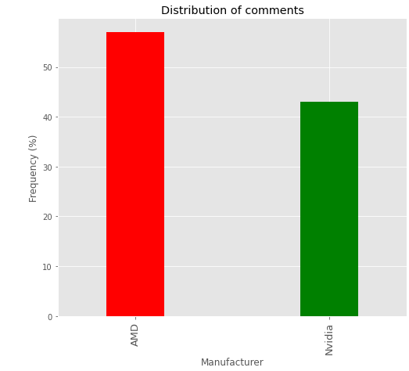
EDA: Distribution of amd and nvidia’s comments
Around 56% of the comments were from AMD and 44% of the comments were from Nvidia

Slide 8
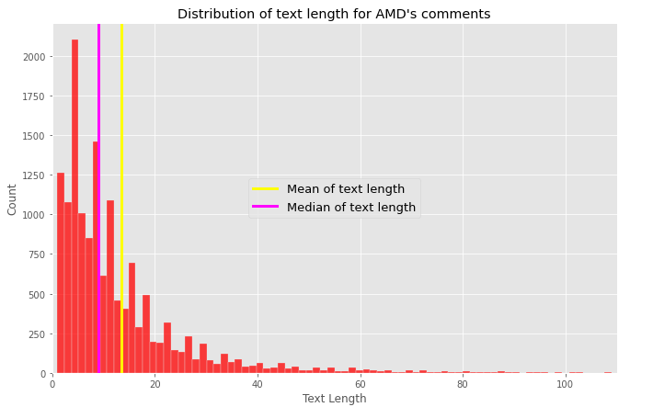
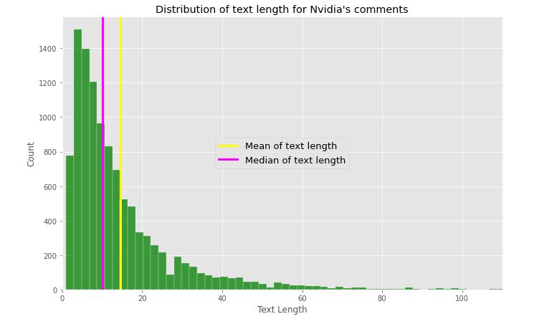
EDA: Distribution of text length
Notes:
Mean of AMD’s text length: 13
Median of AMD’s text length: 9
Mean of Nvidia’s text length: 14
Median of Nvidia’s text length: 10

Slide 9
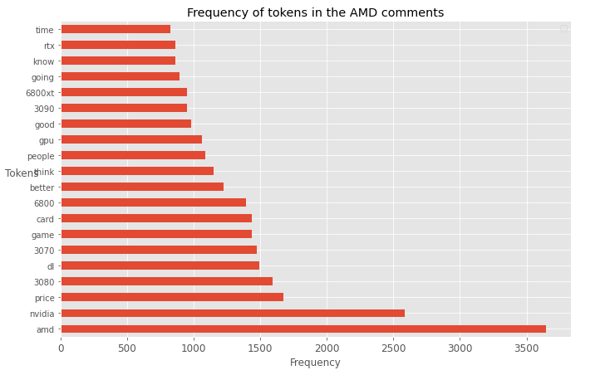
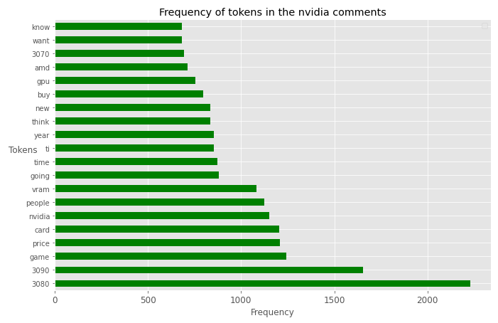
EDA: Frequency of tokens
Notes:
Other than amd and nvidia tokens which appear frequently, the frequency of Nvidia’s models appear larger in the AMD’s subreddit with 3070 and 3080 coming on top compared to AMD’s 6800 and 6800xt. These seem to suggest that Nvidia GPUs price/performance is much larger compared to AMD. Game tends to appear often in both subreddits which suggests that the subreddit is mostly filled with gamers.

Slide 10
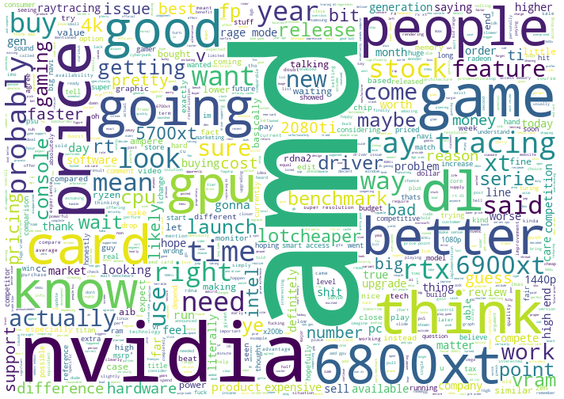
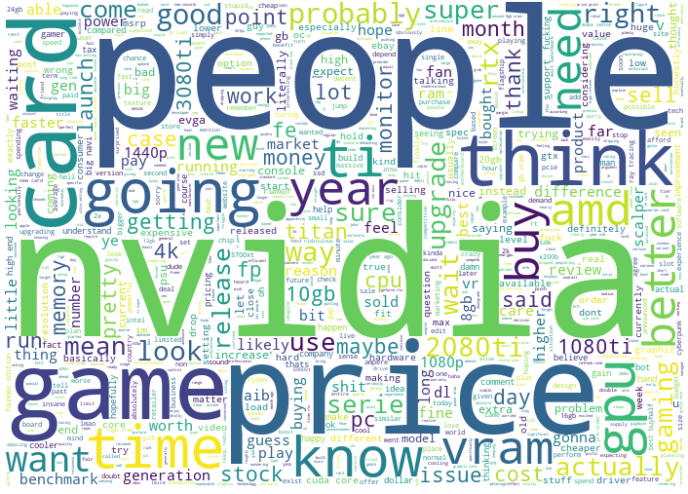
EDA: Word clouds on nvidia and amd’s comments
r/AMD’s word cloud
r/Nvidia’s word cloud

Slide 11

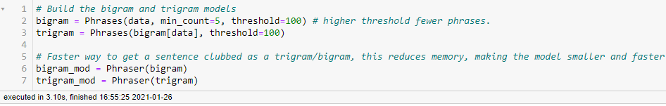
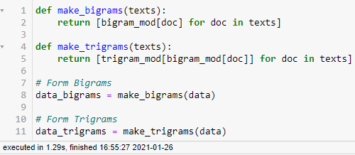
Prepare the data for modeling
Create the bag of words
Using Genism’s bigram and trigram Phraser
Create the bigrams and trigrams

Slide 12
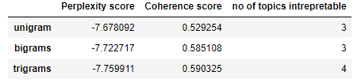
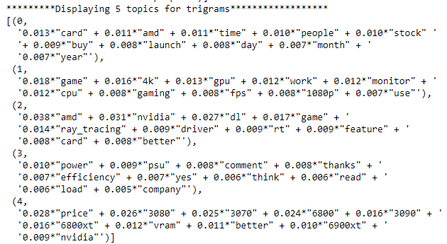
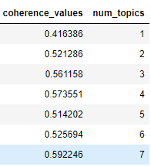
AMD: comparing LDA model and lda mallet results
LDA
LDA Topics
LDA Mallet
Notes:
Perplexity score: how good the model is, lower the better
a perplexity of 100, it means that whenever the model is trying to guess the next word it is as confused as if it had to pick between 100 words
Latent Dirichlet Allocation (LDA)
Coherence score: average /median of the pairwise word-similarity scores of the words in the topic
0: Related to stocks availability.
1: Different resolutions, 1080p and 4k. Monitor and cpu.
2: Talks about DLSS (Deep Learning Super Sampling) and ray tracing which are features in Nvidia's GPUs
3: Talks about the PSU (Power supply unit) and the power efficiency
4: Different models of GPUs
Topic modelling is used for detecting patterns such as word frequency and the distance between the words. It shows words and expressions that appear the most

Slide 13

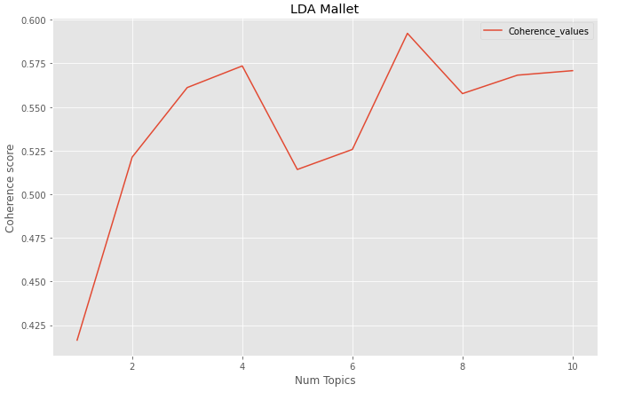
AMD LDA Mallet: Choosing the best k topic
The trigrams data was trained on the LDA mallet model
7 topics was chosen as it had the highest coherence score

Slide 14
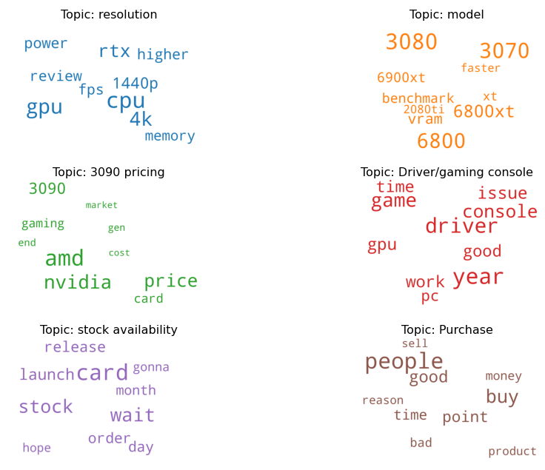
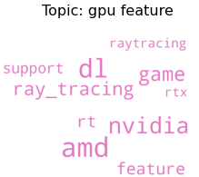
AMD lda mallet: Word cloud of 7 topics
Notes:
Topic: Resolution
GPU's memory plays a more important role than the CPU as the higher the resolution, the more video ram it consumes
Resolution: Surprisingly, 4k resolution has a higher frequency and weight compared to 1440p resolution, which is not so mainstream yet. 1440p resolution is reaching mainstream crowd.
Topic: Model
Nvidia's RTX 3080 and RTX 3070 have a higher word count and weights compared to AMD's 6800 and 6800xt models
I've read some of the comments and it seems the RTX 3070 is faster than the RTX 2080ti, which is the previous generation for almost a third of the price
Topic: 3090 pricing
Most of the topic keyword's topic weights exceed that of their word frequency, which highlights the the keyword's importance
Apparently the 3090 is found the expensive among the consumers
Topic: gpu feature
Ray tracing and dlss (Deep learning super sampling) seems to be the most talked features among the consumers

Slide 15
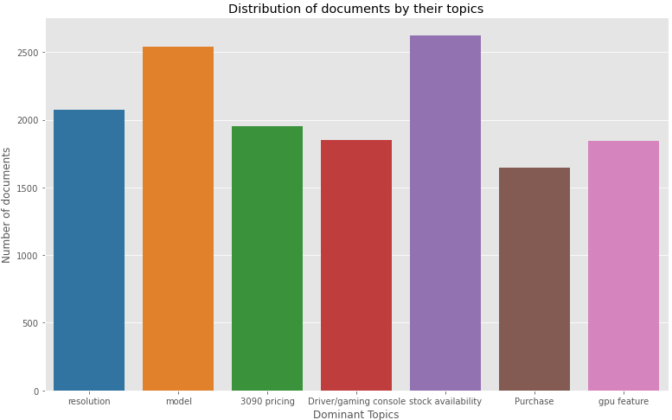
AMD: Distribution of documents by their topics
Notes:
The topic of Stock availability has the largest number of documents assigned to it. It seems that a lack of GPU stock during a GPU launch is a concern for the consumers. Documents are least assigned to the Topic of Purchase, which suggests that consumers have high purchasing power, or the GPUs are underpriced.

Slide 16
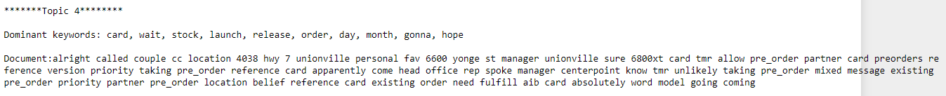
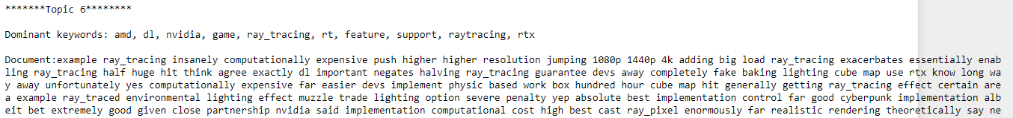
AMD: Most representative documents for topic 4 and 6

Slide 17
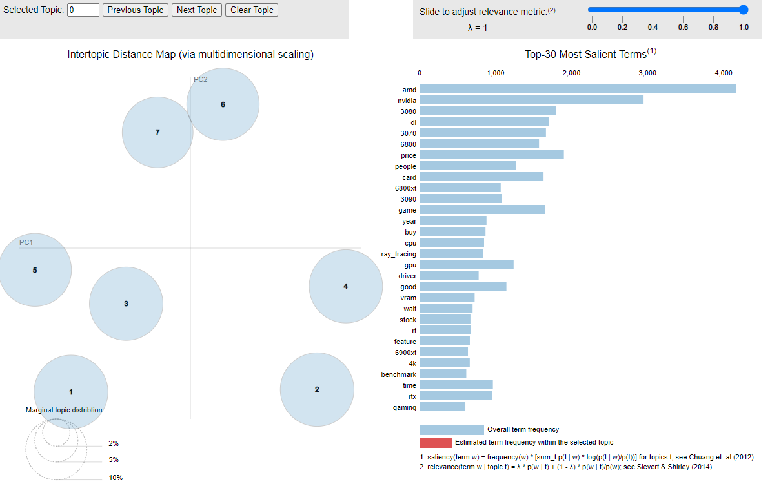
Amd: pyldavis
Notes:
The bubbles are spread far apart compared to the except for topic 7 and 6. This shows that the topics are distinguishable from one another. Also, it seems that the bubbles are of similar sizes which means that the documents are evenly distributed across the topics.

Slide 18
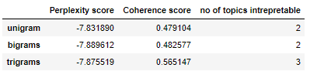
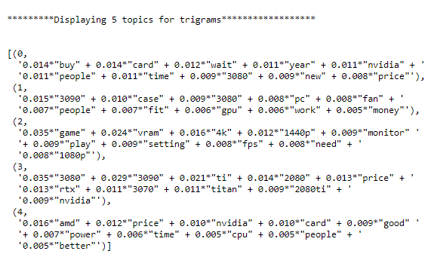
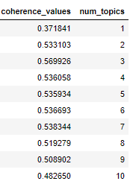
Nvidia comparing LDA model and lda mallet results
LDA
LDA Mallet
Notes:
Perplexity score: how good the model is, lower the better
a perplexity of 100, it means that whenever the model is trying to guess the next word it is as confused as if it had to pick between 100 words
Coherence score: average /median of the pairwise word-similarity scores of the words in the topic
0: Related to stocks availability.
1: Different resolutions, 1080p and 4k. Monitor and cpu.
2: Talks about DLSS (Deep Learning Super Sampling) and ray tracing which are features in Nvidia's GPUs
3: Talks about the PSU (Power supply unit) and the power efficiency
4: Different models of GPUs

Slide 19
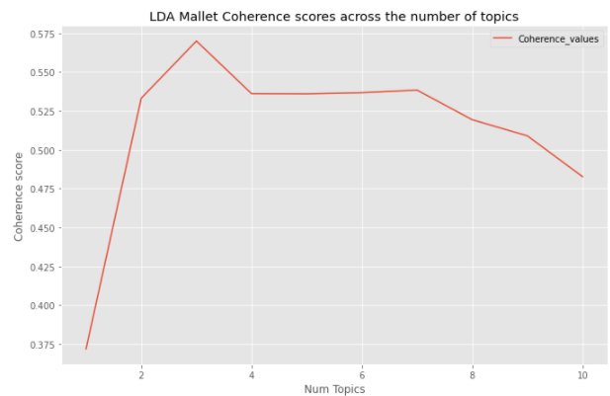
Nvidia LDA Mallet: Choosing the best k topic
The trigrams data was trained on the LDA mallet model
3 topics was chosen as it had the highest coherence score

Slide 20
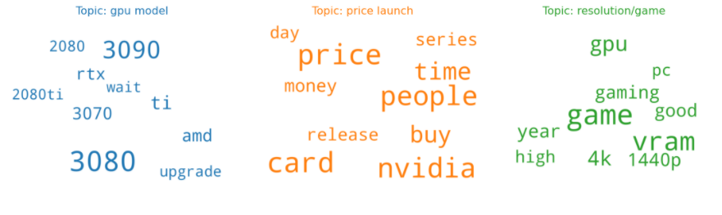
AMD lda mallet: Word cloud of 7 topics
Notes:
Topic: Gpu model
The topic weights and the word count are match up to one another
The 3080 and 3090 are popular GPUs given their high word count and weight
Topic: Price launch
Unlike the keywords in topic gpu model, the word count exceed that of the topic weights assigned which highlights the redundancy of some of the keywords
It looks like the topics weights are about of half the word count.
Topic: resolution/game
Gaming on 4k resolution to be most talked compared to gaming on 1440p resolution as seen in the word count and the topic weight
vram plays a critical role in the resolution as generally the higher the resolution the more vram a game consumes

Slide 21
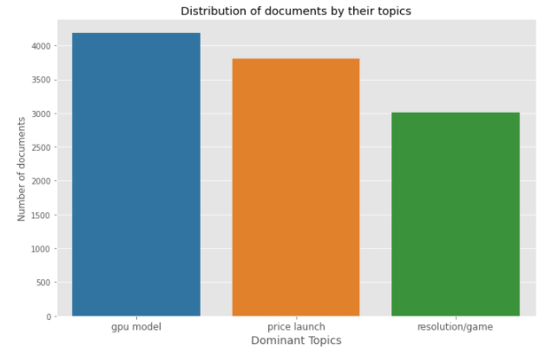
Nvidia: Distribution of documents by their topics
Notes:
The topic of gpu models have a higher document distribution compared to other models, which is quite similar found in AMD’s document distribution which was placed second.

Slide 22
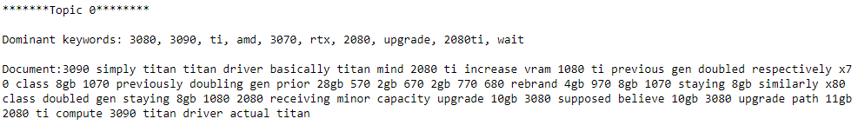
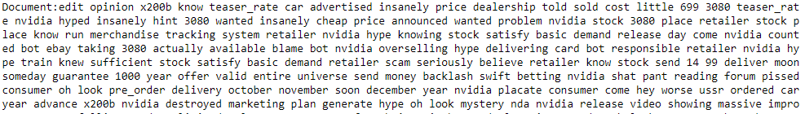
Nvidia: Most representative documents for topic 0 and 1

Slide 23
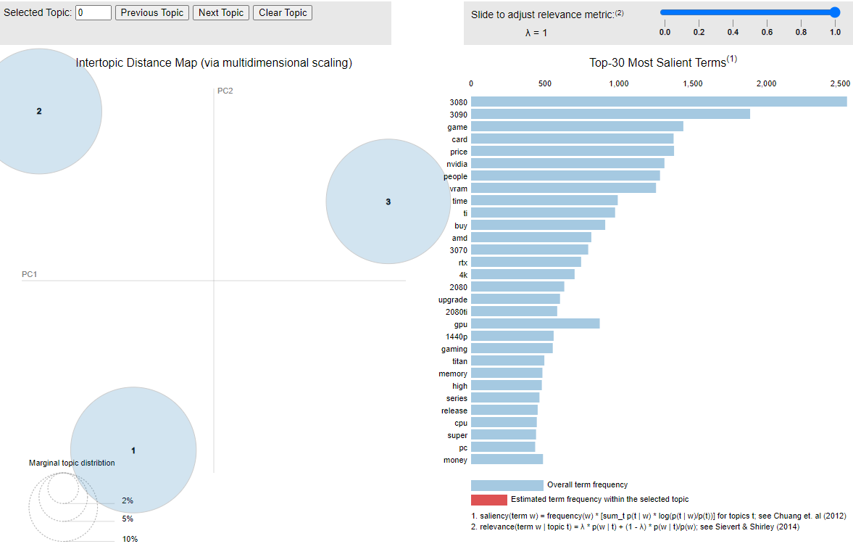
nvidia: pyldavis
Notes:
The bubbles are spread further apart compared to AMD's map. This shows that the model has done an excellent job in clearly distinguishing a topic from one another. Also, it seems that the bubbles are of similar sizes which means that the documents are evenly distributed across the topics.

Slide 24
Project limitations
Data was scrapped from reddit only, which is US-based forum and might form a biased view in the features that consumers are looking out for hence, we can consider scrapping from other forums as well, such as local forums like hardwarezone.
Consider other models like BertTopic and LSA to see if the topics are more interpretable and the topic coherence scores are higher.

Slide 25
conclusion
LDA's mallet coherence score is slightly higher compared to LDA's coherence score and the topics are more interpretable as well.
4k resolution has a higher topic weight compared 1440p resolution which suggests that these GPUs are targeted towards the enthusiast crowd.
Nvidia's RTX 3070 and 3080 seems to be the most popular models, given their high word count and topic weightage.
DLSS and Ray Tracing are coveted features among the users in the subreddit

Slide 26
End of presentation

Slide 27
Appendix

Slide 28
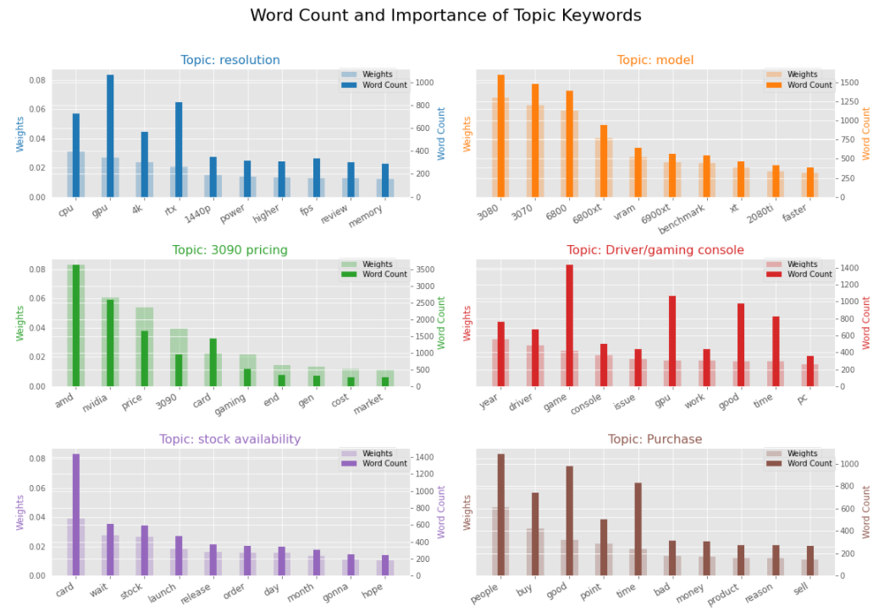
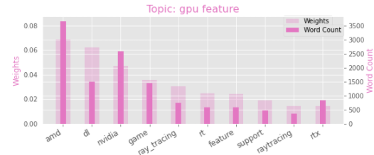
Appendix: AMD word count and weight of topic keywords

Slide 29
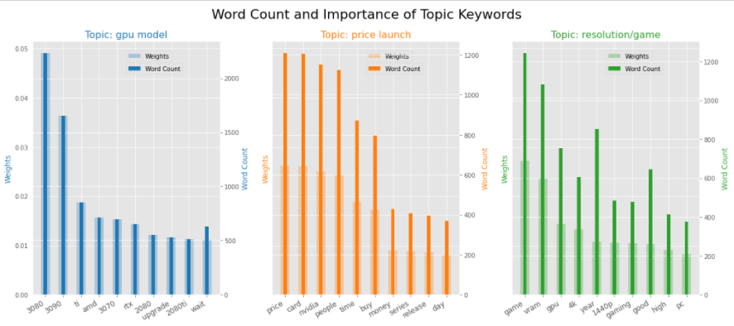
Appendix: nvidia word count and weight of topic keywords

